Slide 1
SATs and Residential evening
St Edward’s
22.01.20
Philippians 4:13 -- I can do all things through Christ who strengthens me
Notes:
This template can be used as a starter file for presenting training materials in a group setting.
Sections
Right-click on a slide to add sections. Sections can help to organize your slides or facilitate collaboration between multiple authors.
Notes
Use the Notes section for delivery notes or to provide additional details for the audience. View these notes in Presentation View during your presentation.
Keep in mind the font size (important for accessibility, visibility, videotaping, and online production)
Coordinated colors
Pay particular attention to the graphs, charts, and text boxes.
Consider that attendees will print in black and white or grayscale. Run a test print to make sure your colors work when printed in pure black and white and grayscale.
Graphics, tables, and graphs
Keep it simple: If possible, use consistent, non-distracting styles and colors.
Label all graphs and tables.

Slide 2
Scaled Scores
Used for reporting national curriculum test outcomes
National standard will be ‘100’
The ‘raw score’ that equates to 100 might be different each year
Raw scores translated to scaled scores using a conversion table
Pupils to receive a raw score, scaled score and confirmation of attainment of the national standard

Slide 3
Key Stage 2
At Key Stage 2 the assessments are in Reading, Grammar, Punctuation and Spelling, Mathematics and Science at:
• working at the expected standard
Science Assessment (if chosen) will be from week Monday 8th June
For Writing:
• working towards the national standard
• working at the expected standard
• working at greater depth within the expected standard
Notes:
Sarah

Slide 4
SATs Dates 2020:
The tests must be taken on the scheduled day.
These dates may be subject to change.
Monday 11th May | English grammar, punctuation and spelling test, Paper 1, short answer questions. English grammar, punctuation and spelling test, Paper 2, spelling
Tuesday 12th May | English reading test, reading booklet and associated answer booklet.
Wednesday 13th May | Mathematics, Paper 1, arithmetic test. Mathematics, Paper 2, reasoning.
Thursday 14th May | Mathematics Paper 3, reasoning.

Slide 5
KS2 English grammar, punctuation and spelling test
As in previous years, there are two papers, Paper 1: questions and Paper 2: spelling.
Paper 1: a single test paper – Grammar and Punctuation
45 minutes to complete the test
Questions worth 50 marks in total
Paper 2: Spelling
An answer booklet for pupils to complete
Pupils will have approximately 15 minutes to complete the test by writing the 20 missing words, read out by the invigilator
spellings are worth 20 marks in total

Slide 6
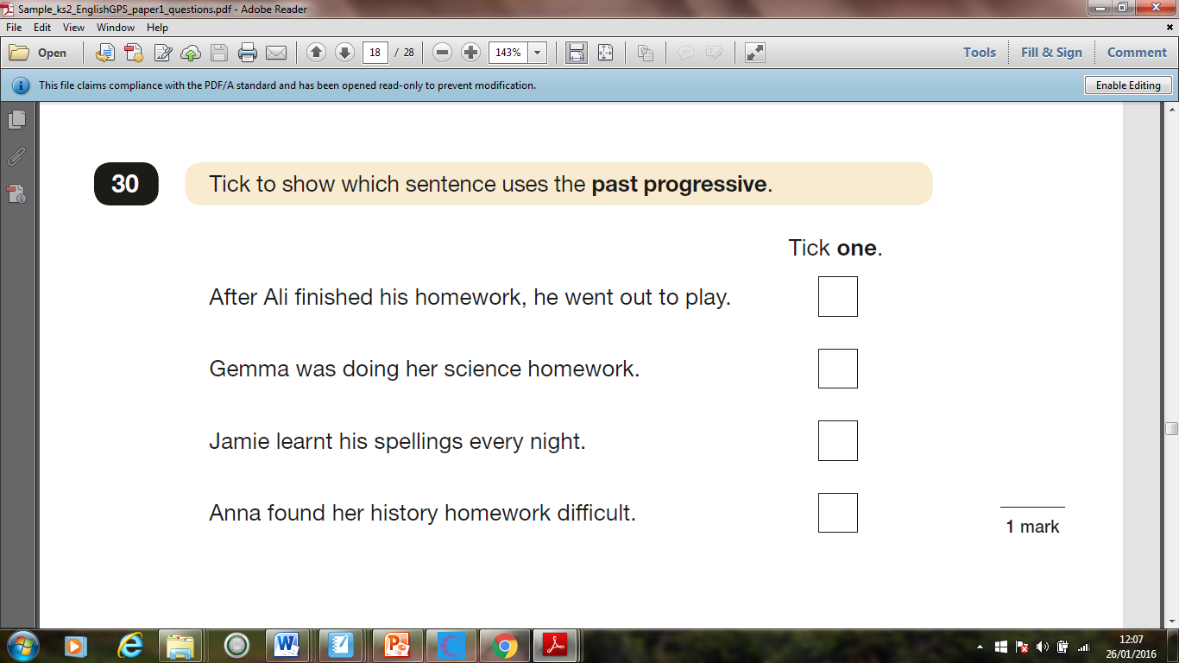

Slide 7
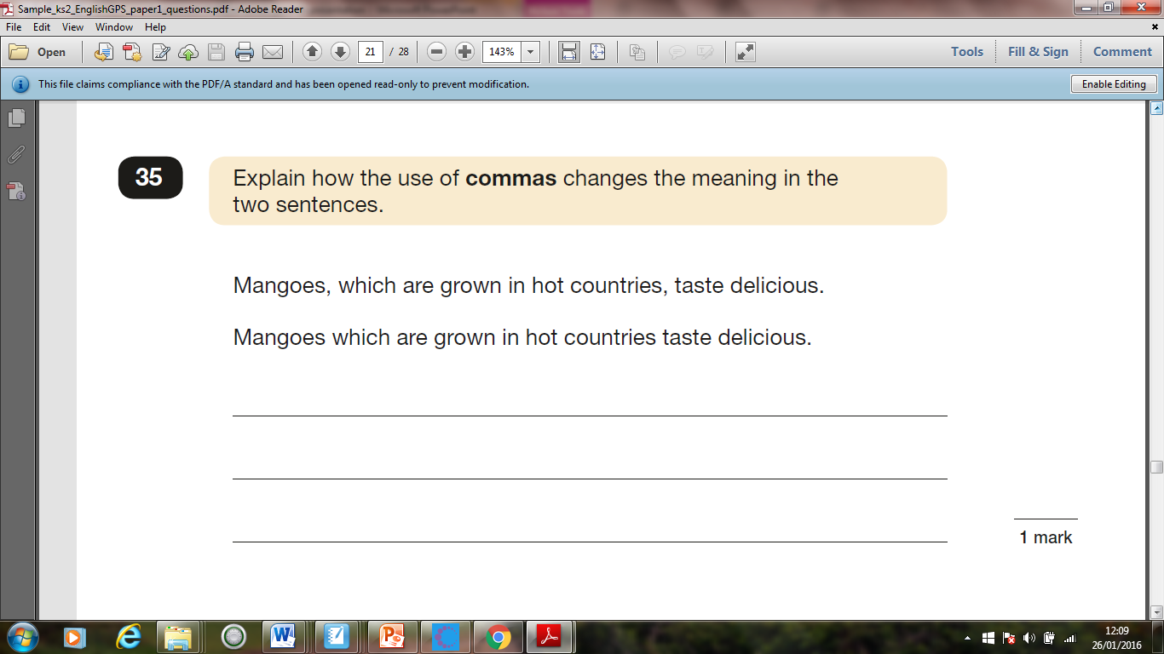

Slide 8
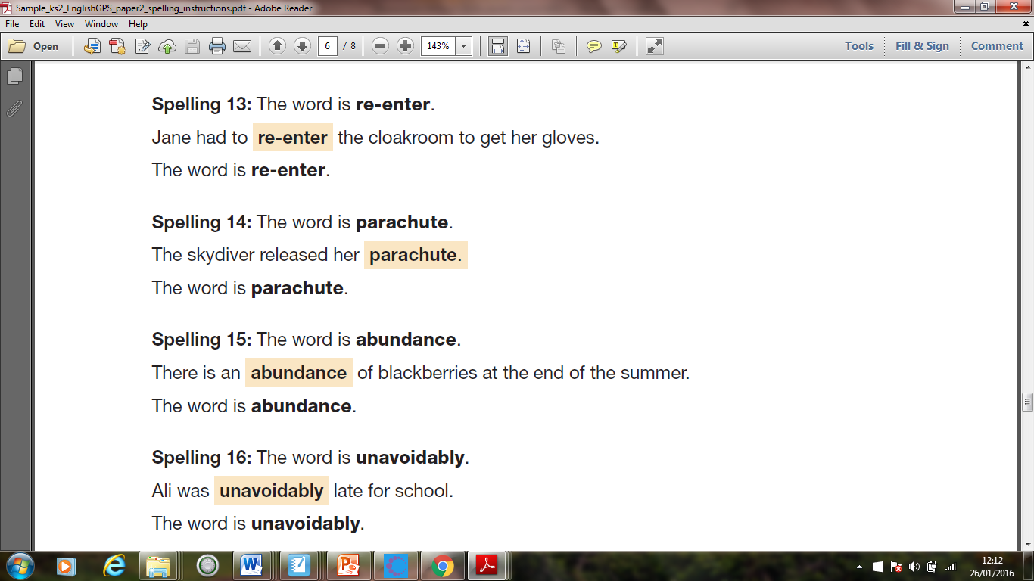

Slide 9
KS2 English reading test
The test consists of a reading booklet and a separate answer booklet.
1 hour to read the 3 texts in the reading booklet and complete the questions at their own pace – ideally 20 minutes per text
A mixture of genres of text.
Pupils can approach the test as they choose: eg working through one text and answering the questions before moving on to the next
Questions are worth a total of 50 marks

Slide 10
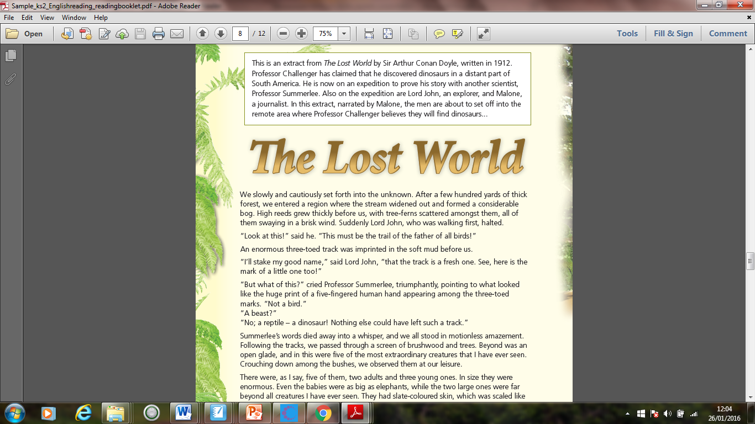

Slide 11
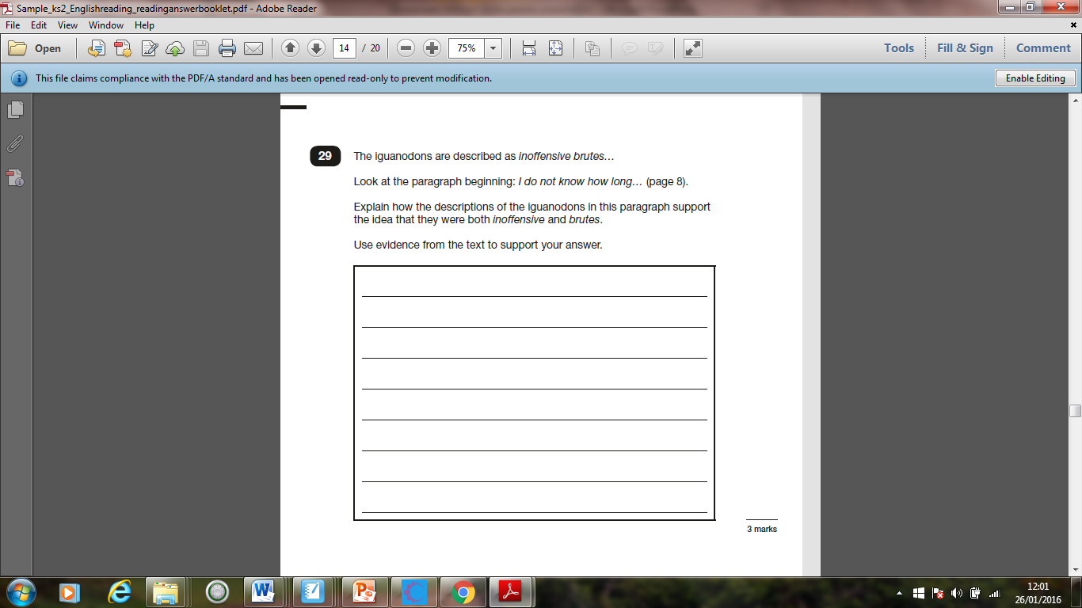

Slide 12
KS2 mathematics test
There are 3 papers; Paper 1: arithmetic; Paper 2: reasoning; and Paper 3: reasoning.
Paper 1: The arithmetic test assesses basic mathematical calculations. The test consists of a single test paper. Pupils will have 30 minutes to complete the test, answering the questions in the test paper. The paper consists of 36 questions which are worth a total of 40 marks.
The questions will cover straightforward addition and subtraction and more complex calculations with fractions worth 1 mark each, and long divisions and long multiplications worth 2 marks each.
Papers 2 and 3 each consist of a single test paper. Pupils will have 40 minutes to complete each test, answering the questions in the test paper. Each paper will have questions worth a total of 35 marks.

Slide 13
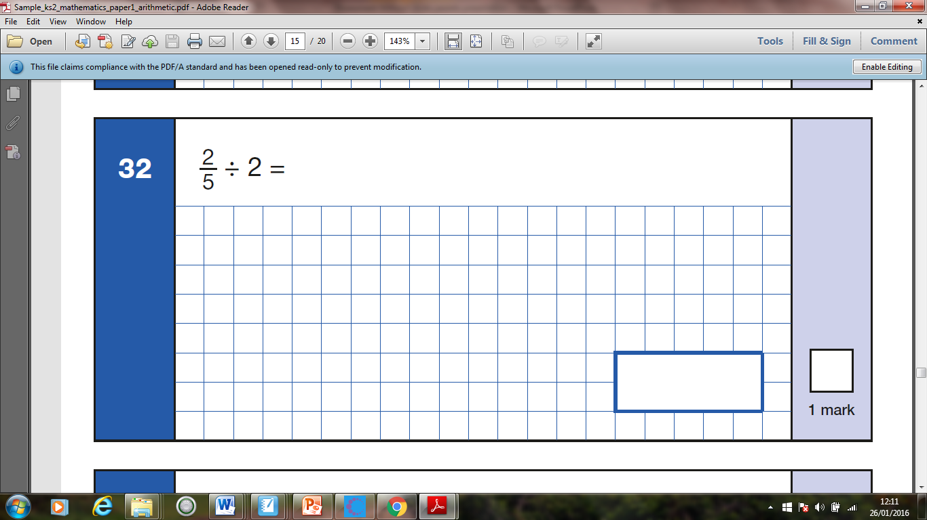

Slide 14
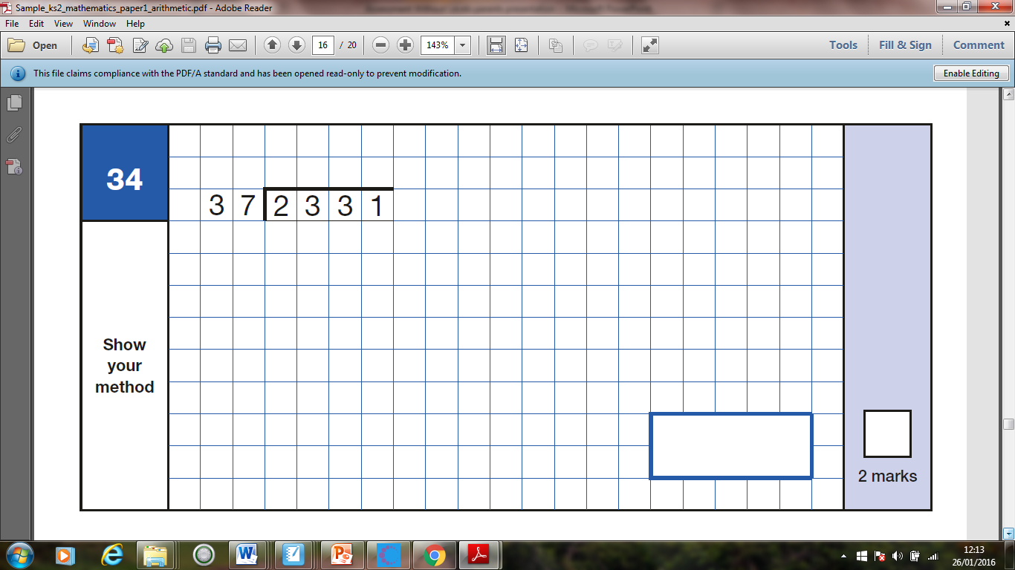

Slide 16
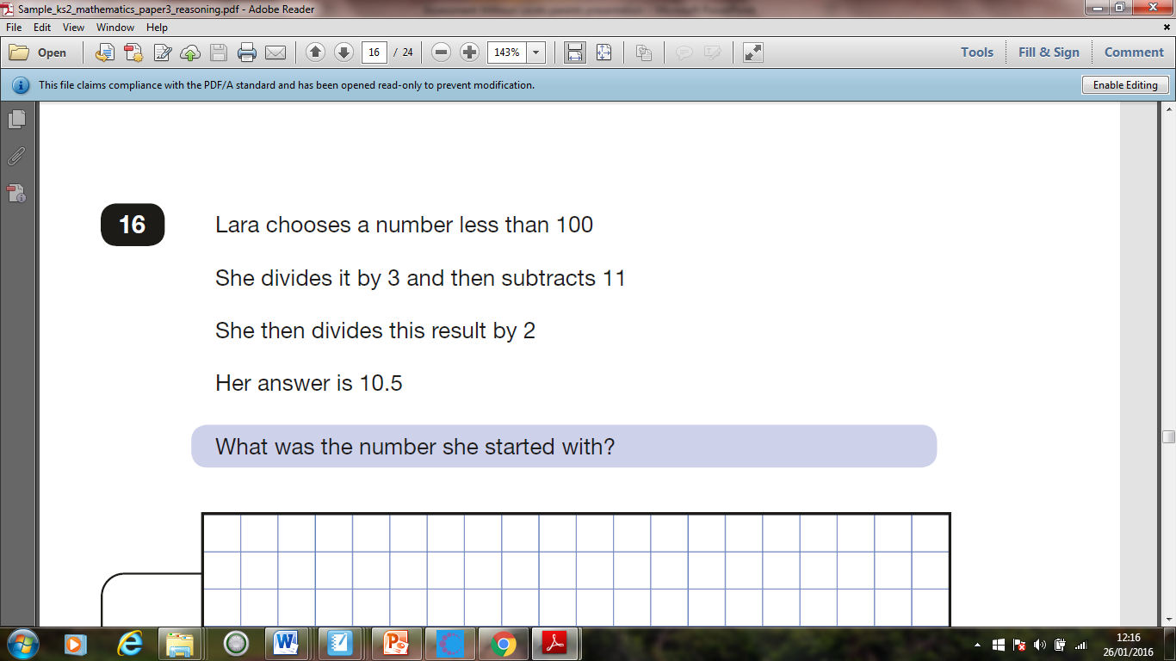

Slide 17
Results will be published in July

Slide 18
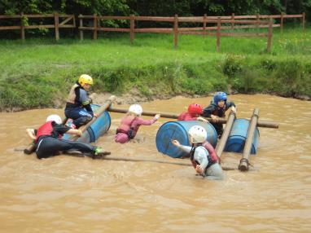
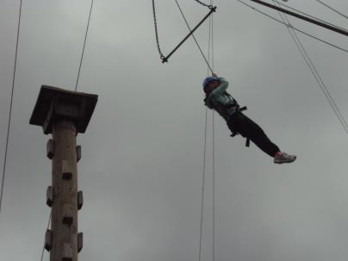
Year 6 Residential Trip Wednesday 20th – Friday 22nd May

Slide 19
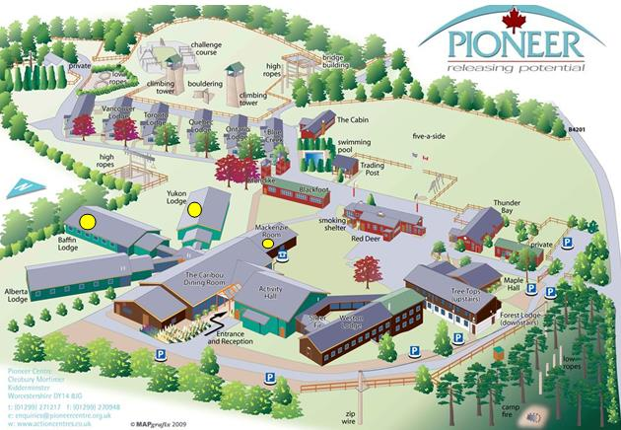
The Pioneer Centre
Shropshire
Approx. 2 hours from Aylesbury
All activities on-site
Girls’ lodge
Boys’ lodge
Common
room

Slide 20
www.acuk.net/pioneer-centre
https://vimeo.com/38632028

Slide 21
Post-SATs celebration!
Offers children time away from home to develop independence
Opportunities to participate in lots of different activities.
A strong emphasis on team games and on activities that present a personal challenge and an opportunity for achievement.
Catholic ethos – time for prayer each day.

Slide 22
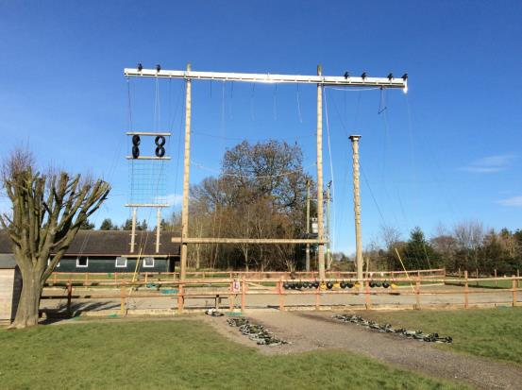
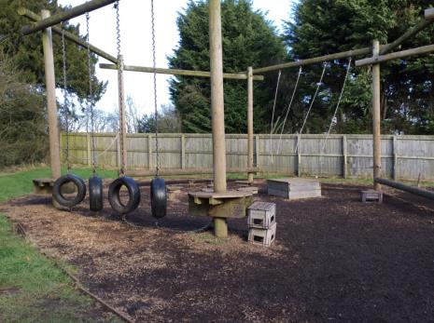
Activities
High ropes
Low ropes

Slide 23
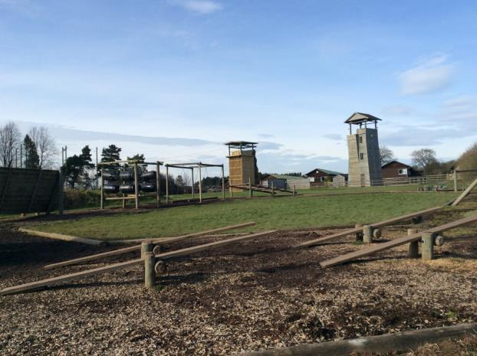
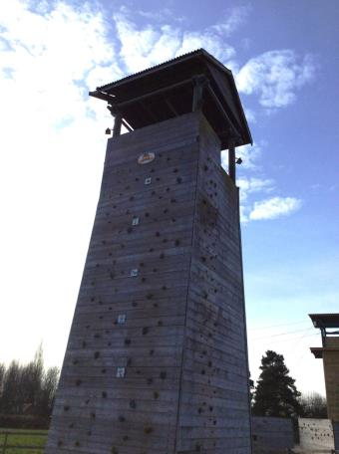
Activities - challenges
Climbing
Abseiling

Slide 24
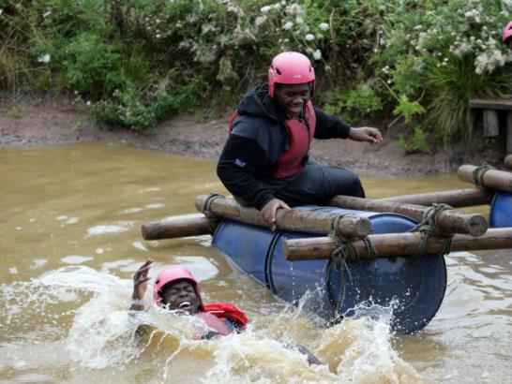
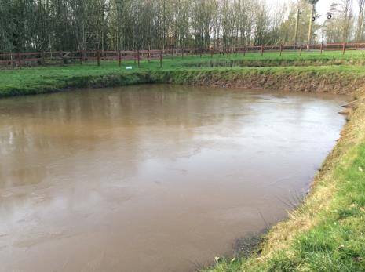
Activities
Raft-building (depth 1m)
Shoes will be lost!

Slide 25
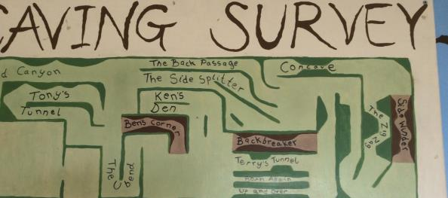
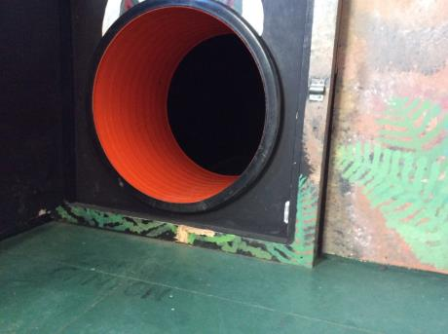
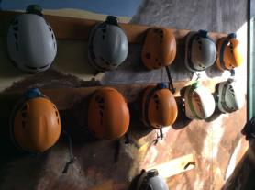
Activities
Caving

Slide 26
Example timetable of a stay at Pioneer Centre
Wednesday 2016 |  |  |  |  | Thursday 2016 |  |  |  |  |  |  | Friday 2016
 | 2-3.30 | 4-5.30 | DINNER TIME | 7.00-8.30 | 9.30-11 | 11.30-1 | LUNCH TIME | 2-3.30 | 4-5.30 | DINNER TIME | 7.00-8.30 | 9.30-11 | 11.30-1 | Depart & Goodbyes
 | Session 3 | Session 4 |  | Session 5 | Session 1 | Session 2 |  | Session 3 | Session 4 |  | Session 5 | Session 1 | Session 2
Group 1 | RAFT BUILDING | ARCHERY |  | DISCO | PIONEER TEAM TRAIL | LOW ROPES |  | FENCING | CAVING |  | CAMP FIRE | ABSEIL/ CLIMBING | HIGH ROPES
Group 2 | RAFT BUILDING | LOW ROPES |  | DISCO | FENCING | ABSEIL/ CLIMBING |  | HIGH ROPES | ARCHERY |  | CAMP FIRE | PIONEER TEAM TRAIL | CAVING
Group 3 | HIGH ROPES | RAFT BUILDING |  | DISCO | ARCHERY | CAVING |  | ABSEIL/ CLIMBING | LOW ROPES |  | CAMP FIRE | FENCING | PIONEER TEAM TRAIL
Group 4 | FENCING | RAFT BUILDING |  | DISCO | ABSEIL/ CLIMBING | PIONEER TEAM TRAIL |  | ARCHERY | CAVING |  | CAMP FIRE | LOW ROPES | HIGH ROPES
Group 5 | LOW ROPES | ABSEIL/ CLIMBING |  | DISCO | CAVING | HIGH ROPES |  | FENCING | RAFT BUILDING |  | CAMP FIRE | PIONEER TEAM TRAIL | ARCHERY

Slide 27
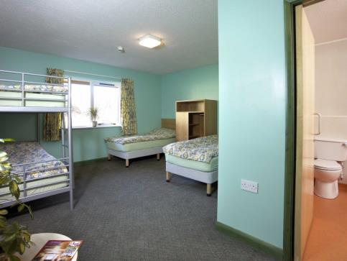
Accommodation
Separate lodges for boys and girls
At least 3 members of St Edward’s staff per lodge
En-suite bathrooms
3 - 5 children per room

Slide 28
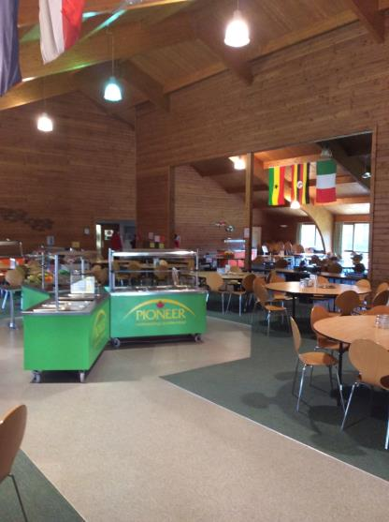
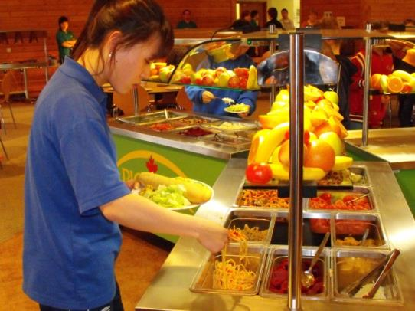
The dining room – great food!

Slide 29
Sample Menu
Wednesday - Evening day 1 Option 1: Vegetable lasagne with roast potatoes, beans, carrots, and gravy OR Option 2: Roast chicken with roast potatoes, beans, carrots and gravy
OPTION 1 | 6 | OPTION 2 | 54
Thursday - Lunch day 2 Option 1: Sausage roll with salad bar OR Option 2: Jacket potato with cheese and beans and salad bar
OPTION 1 | 22 | OPTION 2 | 38
Thursday - Evening day 2 Option 1: Battered cod with chips, peas and salad bar OR Option 2: Pizza with chips, peas and salad bar
OPTION 1 | 15 | OPTION 2 | 45
Friday - Lunch day 3 PACKED LUNCH Provided by the centre.
Packed lunch required on Wednesday (plastic bags)
Please inform us of dietary requirements!

Slide 30
Arrangements - TBC
Arrive at school by 8:30am on Wednesday 20th May.
Children will need to bring a packed lunch in a disposable bag.
Depart at 9:00am.
Arrive back at school on Friday 22nd May at approximately 4:15pm (please note updates on arrival time will be posted via the school twitter account)

Slide 31
Supervision
8 members of St Edward’s staff
5 Activity Leaders from Pioneer (who are based at the centre)
Each group of children is assigned a leader from the centre and a member of school staff who stay with them all week
Children are well supervised

Slide 32
What to bring
Kit list –https://www.acuk.net/sites/default/files/downloads/Pioneer%20Centre/Suggested%20Kit%20list.pdf
Waterproof bag
Pocket money – approximately £5
No electronic devices

Slide 33
Medication
Please ensure that all medication for the trip is given to the office by FRIDAY 15th MAY
Designated staff will administer medication at the prescribed times
Children will carry their own inhalers

Slide 34
Paperwork: A Pack will be sent to you before the Easter holiday
Consent and Medical Information form
Prescribed medication form
Code of Conduct
Clothing list
Photographic consent form
Please return by MONDAY 11th MAY

Slide 35
Cost
The cost of the residential is £234 per child
Deposit of £50 by Monday 3rd February
It can be paid in 3 instalments:
1st payment £62 payable by Friday 28th February 2020
2nd payment of £61 payable by Tuesday 31st March 2020
3rd payment of £61 payable by Friday 24th April
Pay via ParentMail
Letters have been sent out with the details of instalments previously

Slide 36
Coming Home
Your child will be really looking forward to seeing you!
We will be returning to school at approximately 4:15pm. Please make arrangements for your child to be collected.

Slide 37
Questions?
Please speak to us if you have any worries or concerns.
Medical issues – please speak to your child’s class teacher if concerned after completing the form.

