Slide 1
Welcome to Year 6
Mrs Ramsbottom Mrs Burns
Mr Deboub
Mrs Capocci
Mrs Santos

Slide 2
General expectations
Be respectful
Be responsible
Be safe
Set an example to the rest of the school
Develop independent learning skills (secondary-ready)
Complete homework on time and to a high standard

Slide 3
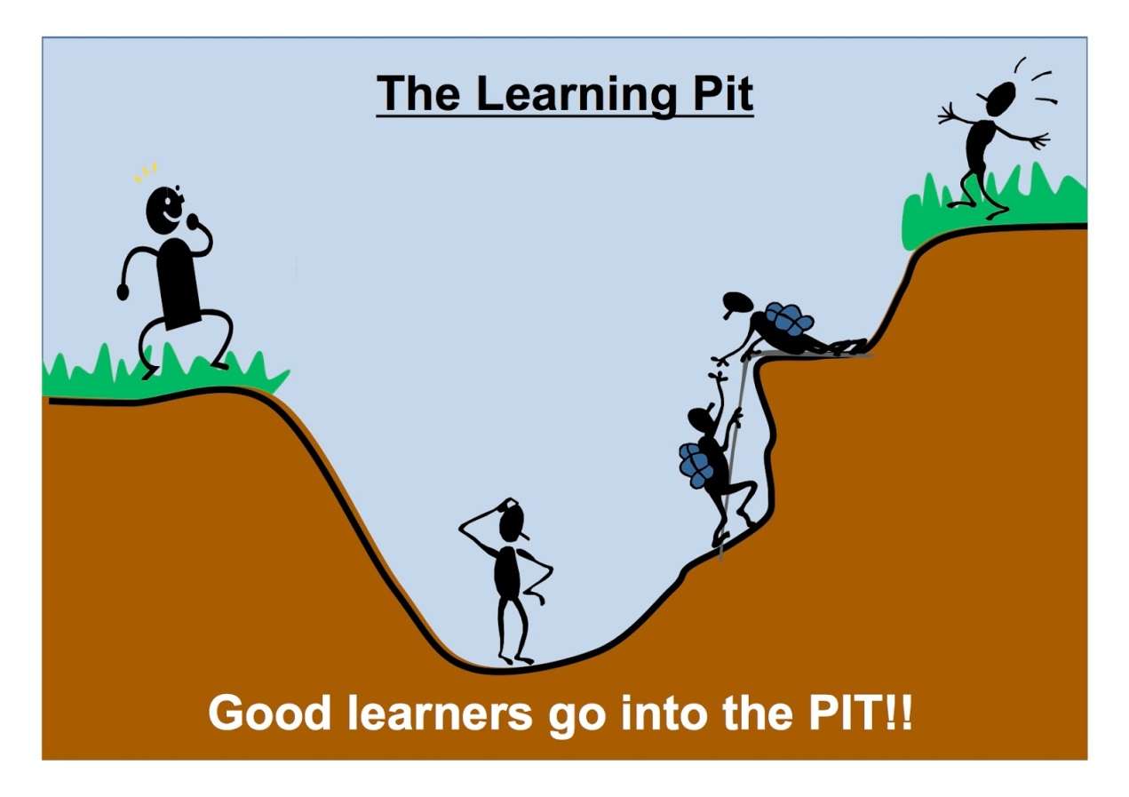
Risk-taking
Resilience
Reflection
Should find their learning challenging
Develop strategies to become independent

Slide 4
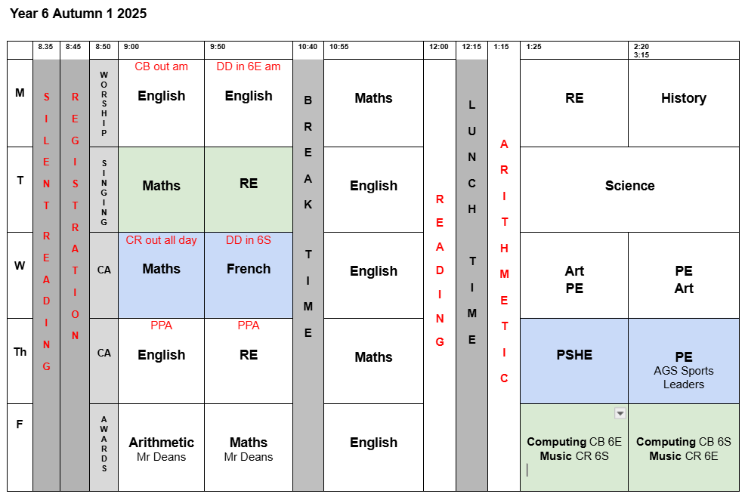

Slide 5
PE
Wednesday afternoon
Thursday afternoon (AGS Sports Leaders)
Children will change into black tracksuit trousers/shorts and trainers just before lesson (PE kit kept in locker)
Autumn term:
Hockey
Basketball/Handball
Gymnastics

Slide 6
Homework
Reading
Every day – at school and at home
Log in to Accelerated Reader at home to complete book quizzes – at least once every fortnight

Slide 7
Homework
Atom Learning
Maths - weekly task set on Atom Learning (plus Times Table Rock Stars)
English - weekly task set on Atom Learning
Both tasks will be set on Wednesdays – to be completed by the following Wednesday.

Slide 8
History/Geography
Autumn Term
History: What was the impact of World War Two on British people?
Geography: How do volcanoes affect the lives of people on Heimaey?

Slide 9
History/Geography
Spring Term
History: What does the census tell us about our local area?
Geography: Why is Fair Trade fair?

Slide 10
History/Geography
Summer Term
History: Unheard histories - who should feature on the £10.00 banknote?
Geography: How is climate change affecting the world?

Slide 11
Secondary Transfer
Results of 11+ sent on 10th October by email - you must register with Bucks
Friday 31st October – Deadline for online school applications
Applications for St Michael’s – Make sure you complete the supplementary form!
Specify Aylesbury not Wycombe

Slide 12
SATs Week
Monday 11th May 2026
English Grammar, Punctuation and Spelling Paper 1: Questions
English Grammar, Punctuation and Spelling Paper 2: Spelling
Tuesday 12th May 2026
Reading paper
Wednesday 13th May 2026
Mathematics Paper 1: arithmetic
Mathematics Paper 2: reasoning
Thursday 14th May 2026
Mathematics Paper 3: reasoning

Slide 13
Year 6 Residential
Pioneer Centre in Shropshire
Wednesday 20th – Friday 22nd May 2026
Residential information evening - Thursday 20th November 6pm (online)

Slide 14
And finally...
If you have any questions, please email them to:
office.sejs@stjosephsandstedwards
We look forward to working in partnership with you, to make this last primary school year a hugely successful and enjoyable one for the children.

