Slide 1

4S - Mrs Fahey
4E – Mr Osborne
Welcome to Year 4
Notes:
‹#›

Slide 2
The School Day
Children can arrive from 8.35 for register at 8.45am
Break time 10.35am
Lunch 12.15pm
Home time 3.15pm
Notes:
‹#›

Slide 3
General expectations
Come into the classroom ready to learn
Behaviour - Respectful, Responsible, Safe
Notes:
‹#›

Slide 4
General expectations
Uniform (please make sure it is clearly labelled)
PE days (Monday and Wednesday).
Kit expectations.
Swimming/ P.E - no jewellery please.
Notes:
Slips available for those that want reminder
‹#›

Slide 5

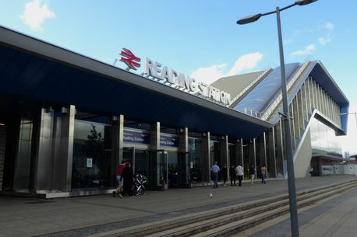
Reading
Reading at home 2 - 3 times a week is recommended
Accelerated Reader
AR bookfinder
AR Quizzes – morning and afternoon - in school or unlimited time at
home.

Slide 6


Promoting Reading for Pleasure
at home

Slide 7

There is strong evidence linking reading for pleasure and educational outcomes.
Reading
increases our understanding of our own identity
improves empathy and
gives us an insight into the world view of others.

Slide 8

Reading Role Models
We need to make sure that the children see us reading.
The more they see the adults around them read, the more they will consider doing it themselves.
Show them that it is fun!

Slide 9
Bedtime Stories
Reading to your child for just 10 minutes a day/night can improve their vocabulary, encourage them to read independently and can also improve parent/child relationships. Older children love a bedtime story too (even if they won’t always admit it!).
Bedtime stories can be whatever you and your child want to read together! Extra tip - Do your voices! You can have a good giggle together.
If you don’t feel confident reading aloud, there is CBeebies bedtime story, but do this as family activity rather than the children on their own, then you can talk about the story afterwards.

Slide 10

Book Talk
Informal book talk can be a fantastic way to discuss what has been read. Picture books lend themselves well to informal book talk because children want to explore and discuss pictures.

Slide 11
Book Talk
Make links and connections
Do the characters/settings remind you of anyone/anywhere? Have you been in a similar situation? Have you learnt about this from TV/School?
Make predictions
Can you guess what the story is about? What will happen next?
Discuss/Introduce vocabulary
If there is a tricky word, can you explain what it means?
Discuss emotions
How does this story make you feel?

Slide 12
Allow their choices
We need to allow children to read what they want (within reason). Some children may find comfort in re-reading a book. There is nothing wrong with it at all. Children may notice new things with each reading!
Comics, graphic novels and audiobooks are all valid materials and shouldn’t be looked down upon.
Imagine that books are like food … . Comfort reads are not nutritional but we still love them (just in moderation). Harder richer texts are delicious, but too many can make us a little overwhelmed and needing of something easier occasionally.

Slide 13
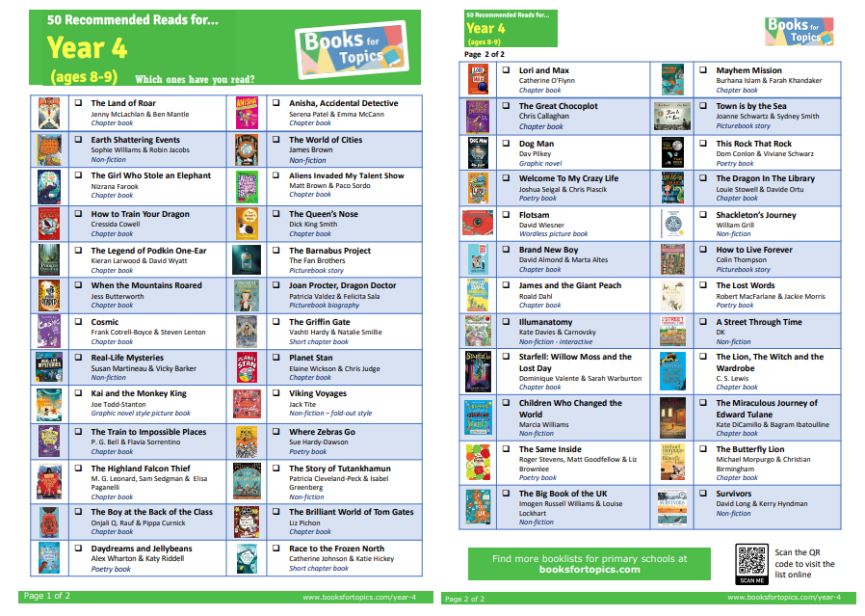

Slide 14

Maths
TTRS
Multiplication check
Atom Maths
Look on our website
Daily Arithmetic session
https://www.stedwards.bucks.sch.uk/assets/Documents/Attachments/Maths-Calculations-Policy.pdf

Slide 15
Homework aims to....
Reinforce and extend work taking place in school.
Encourage children to become more independent and organised in their learning.
Involve you in your child’s learning
Year 4 should be confident with all
times tables.
Notes:
‹#›

Slide 16
Homework
Reading daily
English and Maths task set on Atom
Research or RE tasks when appropriate
Times Tables Rock Stars
Notes:
‹#›

Slide 17
Helping Your Child
Listen to your child read as often as possible and enjoy talking about books.
Reinforce times tables and number bonds.
Make maths an every day fun activity.
Make sure your child is aware of Online Safety and Stranger Danger (Clever Never Goes)
Notes:
‹#›

Slide 18
History / Geography topic
Term 1a: -How and why is my local area changing?
1b: - How hard was it to invade and settle in Britain?
Term 2a: - How have children’s lives changed?
2b:- How can we live more sustainably?
Term 3a:- How did the achievements of the Ancient Maya impact
their society and beyond?
3b:- Why are jungles so wet and deserts so dry?
Notes:
‹#›

Slide 19
School trips
We have two trips booked for this school year.
November - Ashmolean Museum (history focused)
May - Kew Gardens (geography and science focused)
Notes:
‹#›

Slide 20
And finally...
If you have any queries or concerns please do not hesitate to contact us at
Year-4@stedwards.bucks.sch.uk
We look forward to working in partnership with you, to make this year a hugely successful and enjoyable one for the children.
Notes:
‹#›

