Slide 1

Welcome to Year 4
2026/2027 • Parent Information Evening
Mrs Mahony and Mr Osborne
St Edward's Catholic Junior School, Aylesbury
“We love because God first loved us” — 1 John 4:19

Slide 2
Welcome to Year 4
A year of growing independence, confidence and curiosity
A warm welcome to all Year 4 children and families.
Our aim is to help every child thrive academically, socially, spiritually and physically.
We will build independence while making sure children know when and how to ask for help.
Home and school working together makes a real difference.
St Edward's Catholic Junior School • Year 4

Slide 3
Our Catholic ethos
Faith is at the heart of school life, with Gospel values underpinning our work.
We encourage children to recognise their gifts and talents and use them positively.
Prayer, reflection, service, kindness and respect are part of everyday life.
We want children to become the best version of the person God intended them to be.
St Edward's Catholic Junior School • Year 4

Slide 4
The School Day
  Arrival from 8:35am
  Register at 8:45am
  Break time 10:35am to 10:50am
  Lunch 12:15pm to 1:15pm
  Home time – dismissed after 3.15pm
St Edward's Catholic Junior School • Year 4

Slide 5
Year 4 learning
A broad, balanced and carefully sequenced curriculum
Core learning
Wider curriculum
English:
reading, writing, spelling, vocabulary and grammar
Maths:
fluency, reasoning and problem solving
RE:
developing knowledge and understanding of the Catholic faith
Science
Computing
PSHE
History
Geography
Art and DT
Music
French
PE including Swimming
Forest School
St Edward's Catholic Junior School • Year 4

Slide 6
Reading and English
Building confident, thoughtful and independent readers
Encourage regular reading at home and talk about books together.
Ask children to explain characters, vocabulary, events and their opinions.
Use school reading resources and Accelerated Reader where appropriate.
Support reading for pleasure: children benefit from choosing books they genuinely enjoy.
St Edward's Catholic Junior School • Year 4

Slide 7
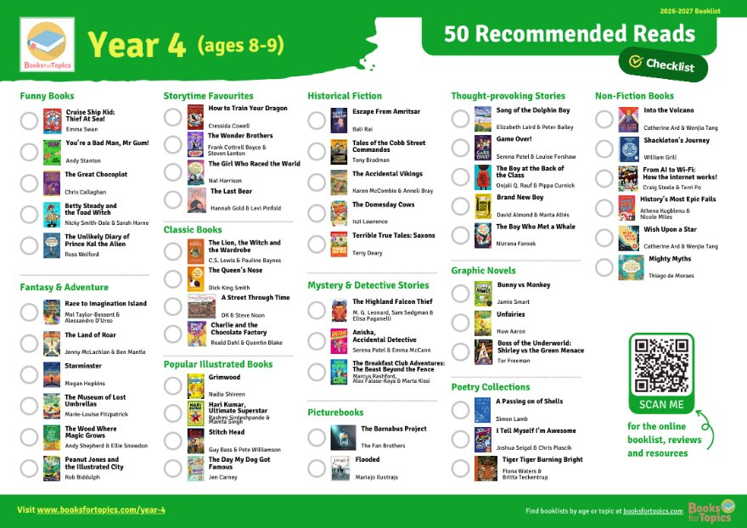
Reading and English
Building confident, thoughtful and independent readers
St Edward's Catholic Junior School • Year 4

Slide 8
Maths and times tables
Year 4 is an important year for developing secure multiplication and division facts.
Regular short practice is more useful than occasional long sessions.
Encourage children to explain how they reached an answer, not just give the answer.
Useful school platforms include Times Tables Rock Stars and Numbots.
Multiplication Tables Check
June 2027
Computer based test
25 questions
Children have 6 seconds to answer each question
St Edward's Catholic Junior School • Year 4

Slide 9
Homework and home learning
The goal is to reinforce learning and develop good independent habits.
Prioritise reading, times-table practice and any tasks set by the class teacher.
Create a calm routine: a little and often is usually most effective.
If homework becomes a source of significant difficulty, please communicate with the teacher.
Atom Learning
Maths
English
Spellings
TTRockStars – Try to do 3 to 5 minutes daily
St Edward's Catholic Junior School • Year 4

Slide 10
School uniform
Simple, practical and consistent
Standard uniform
Summer uniform
Navy sweatshirt or sweat cardigan with school badge
White polo shirt — with badge or plain white
Black tailored trousers, or black skirt/pinafore approximately knee length
Black or white short/knee-length socks or black tights
Plain black, sturdy, waterproof school shoes
Available from the Easter holidays to October half term
Navy sweatshirt/cardigan and white polo shirt
Black tailored shorts OR blue-and-white checked summer dress
Black or white ankle or knee-length socks
Plain black, sturdy, waterproof school shoes
Please label all items of clothing
Please check the school's current uniform page before purchasing items

Slide 11
PE and physical activity
Helping children develop skills, confidence, teamwork and enjoyment
What we want children to develop
PE kit reminders
Movement and coordination
Fitness and physical literacy
Teamwork, communication and fair play
Confidence and resilience
When it will happen
PE timetabled for Monday this term
Swimming on Tuesday mornings for the rest of the school year
Plain black jogging bottoms or shorts — no logos or stripes
Plain black trainers if school shoes are unsuitable for PE
School top or white t-shirt
PE kit stays in lockers and goes home at the end of each half term
PE details based on St Edward's published uniform guidance

Slide 12
Uniform: small details matter
Long hair or hair covering the eyes should be tied back using plain black, white or school-colour accessories.
Jewellery is not permitted; small plain silver or gold studs are allowed for pierced ears at parents' own risk.
Earrings must be removed for PE/swimming; parents provide tape if piercings are new.
No nail varnish or make-up.
Plain black or white socks in the summer, no trainer socks please.
St Edward's Catholic Junior School • Year 4

Slide 13
Routines and expectations
Arrive ready to learn, with the equipment and uniform needed for the day.
Encourage children to take responsibility for belongings and organisation.
Kindness, respect and positive behaviour are expected from everyone.
Celebrate effort, perseverance and improvement — not just the final result.
St Edward's Catholic Junior School • Year 4

Slide 14
Wellbeing and relationships
We want children to feel safe, valued and able to talk to trusted adults.
Encourage children to tell us about worries early, before they become bigger problems.
Friendships can change as children grow; we will support children to resolve difficulties respectfully.
Please keep communication with school open and constructive.
St Edward's Catholic Junior School • Year 4

Slide 15
Attendance, punctuality and readiness
Being in school consistently gives children the best opportunity to benefit from learning and relationships.
Arriving on time helps children settle calmly and begin the day successfully.
Please follow the school's current attendance procedures for illness and absence.
Check the school calendar/newsletter regularly for dates and reminders.
St Edward's Catholic Junior School • Year 4

Slide 16
How parents can support
Read together and talk about what your child is learning.
Practise times tables regularly in short bursts.
Encourage independence: packing bags, organising belongings and remembering routines.
Protect sleep, exercise and downtime.
Praise effort, curiosity and resilience.
St Edward's Catholic Junior School • Year 4

Slide 17
Working together
Please contact us when…
Keep up to date through…
Your child has a worry that is affecting school
There is important information we need to know
You need clarification about learning or homework
School newsletters and diary/calendar
The school website and published information
Messages and communication routes provided by school
The school office for general enquiries
Office.SEJS@stjosephsandstedwards.org
St Edward's Catholic Junior School • Year 4

Slide 18
Three things to remember
1
Encourage independence
2
Read, practice and talk together
3
Keep communication open
Questions?

Slide 19
School information sources
St Edward's Catholic Junior School — Curriculum: www.stedwards.bucks.sch.uk/learning/curriculum/
St Edward's Catholic Junior School — Uniform: www.stedwards.bucks.sch.uk/info/uniform/
St Edward's Catholic Junior School — Welcome: www.stedwards.bucks.sch.uk/our-school/welcome/
School address: Hazell Avenue, Aylesbury, Buckinghamshire, HP21 7JF
School telephone: 01296 424 544
Prepared as a parent presentation draft • Check school communications for the latest dates and procedures

